Slide 1
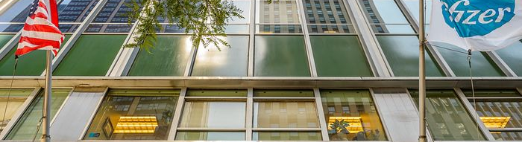
Financial Analysis of Pfizer Inc. (PFE)
Group No. : 09

Slide 2

Team Members
Jayan Francis
Elias Mani
Gayathri Manju Jayasena Kurup
Nitiben Patel
Mohana Krishna Sajja

Slide 3
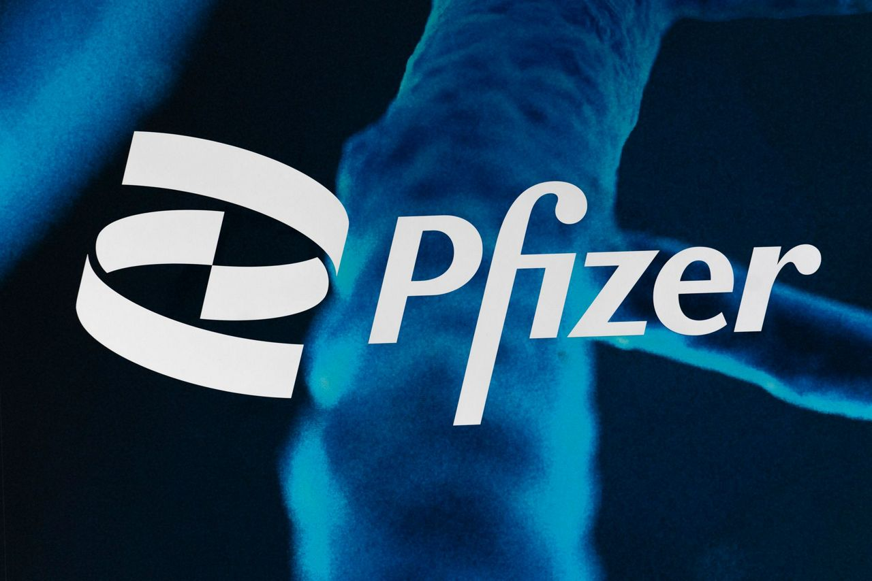

Pfizer Inc. (PFE)
Pfizer Inc. is a multinational pharmaceutical and biotechnology company based in the United States with its headquarters located in Manhattan, New York City at The Spiral.
Pfizer creates and manufactures vaccines and medications in the fields of neurology, endocrinology, immunology, oncology, and cardiology. The Pfizer–BioNTech COVID-19 vaccine, apixaban, a pneumococcal conjugate vaccine, palbociclib, and tafamidis are the company's top products in terms of sales.

Slide 4
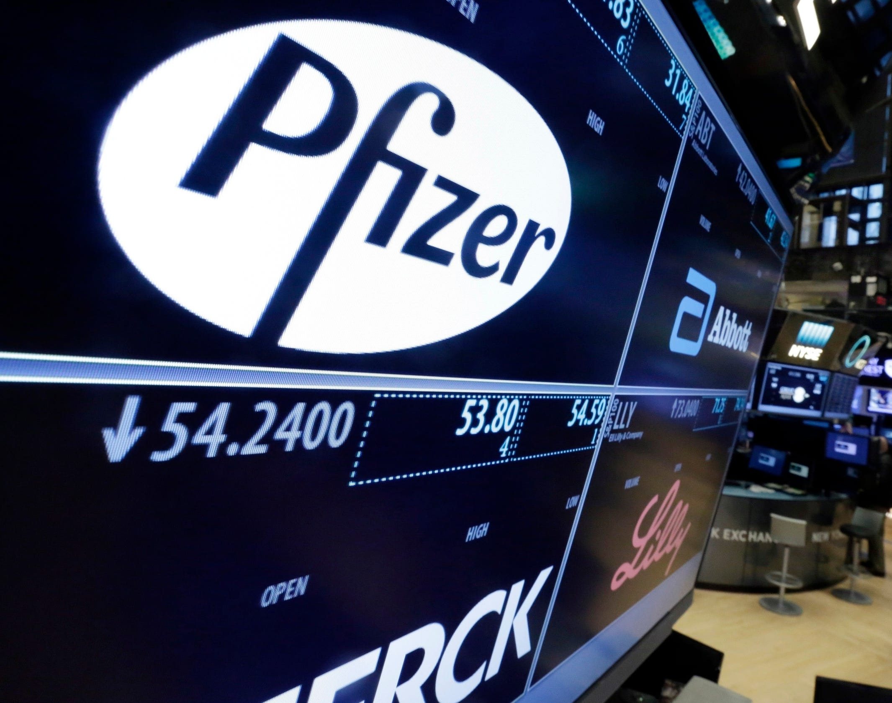
History
Pfizer's history dates back to 1849 when Charles Pfizer and Charles F. Erhart two German businessmen founded the company in Brooklyn, New York. Initially, Pfizer focused on producing chemicals, particularly citric acid. However, in 1950, the company made a significant breakthrough with the discovery of Terramycin, an antibiotic that became one of the company's first major pharmaceutical products. Over the years, Pfizer continued to expand its portfolio through research and development (R&D) and strategic acquisitions.

Slide 5
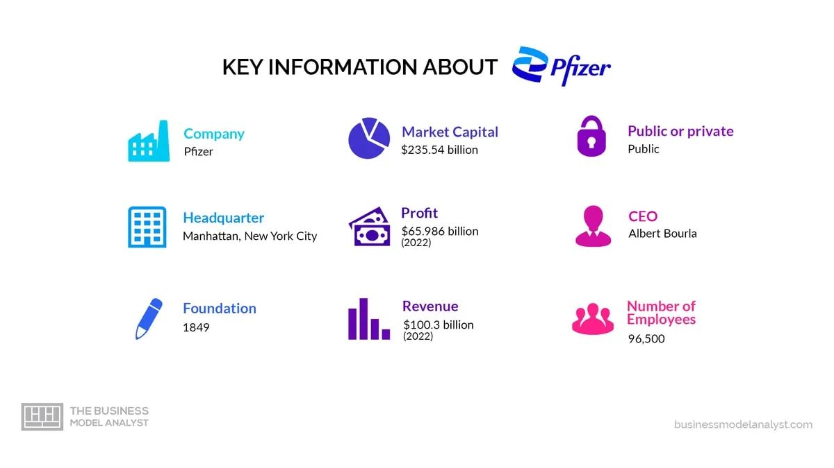

Slide 6
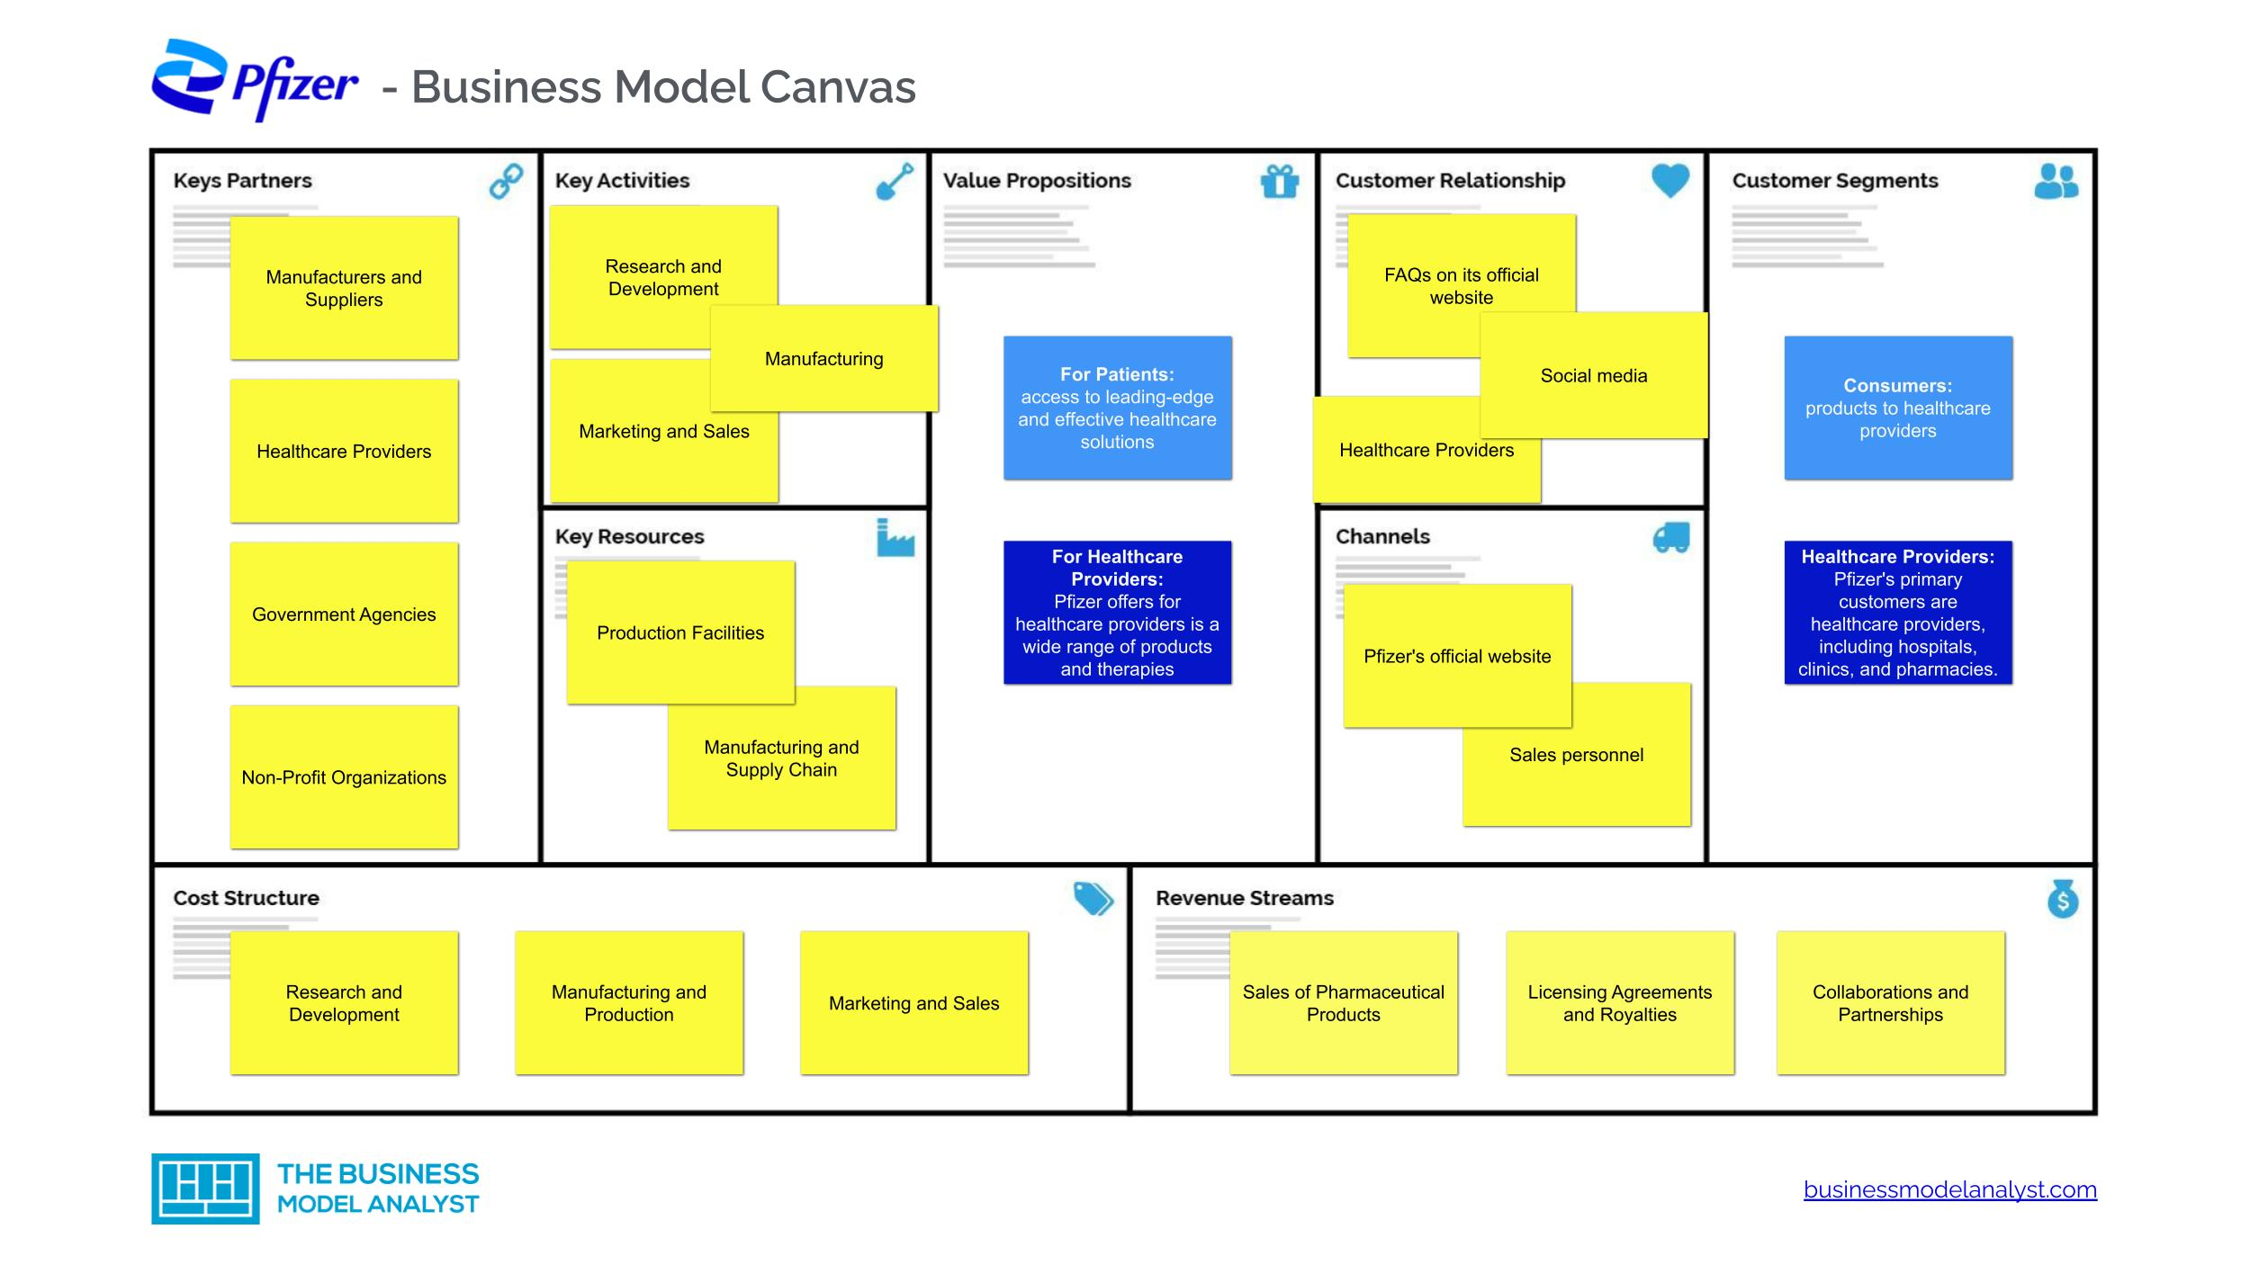

Slide 7
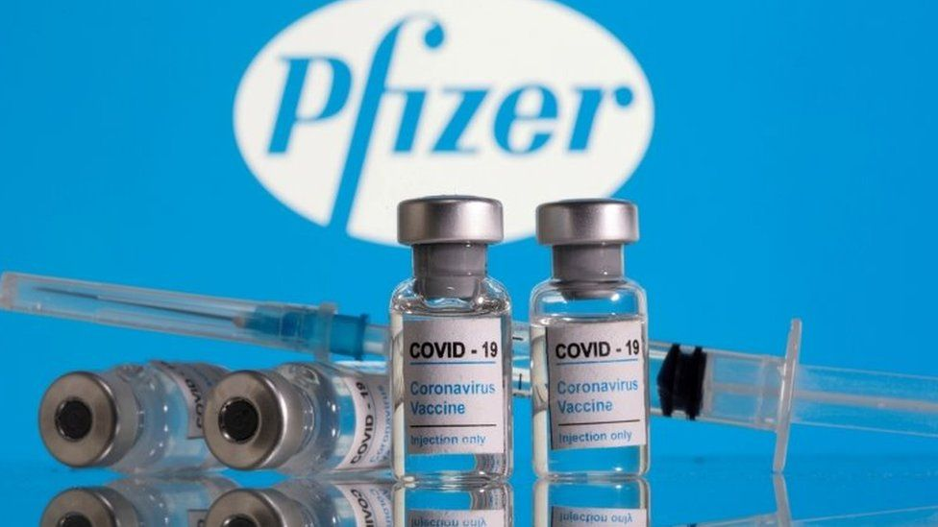
Current Operations
Pfizer is a leading global pharmaceutical company with a diverse portfolio of prescription medicines, vaccines, biopharmaceuticals, and consumer healthcare products. Its product offerings span various therapeutic areas, including cardiovascular, oncology, immunology, and rare diseases. Notable products include Viagra (sildenafil), Lipitor (atorvastatin), and Prevnar 13 (pneumococcal 13-valent conjugate vaccine).
Pfizer operates through two main segments:
Biopharmaceuticals: This segment focuses on the development and commercialization of innovative medicines, including small molecules and biologics.
Upjohn: This segment includes Pfizer's off patent branded and generic established medicines.

Slide 8
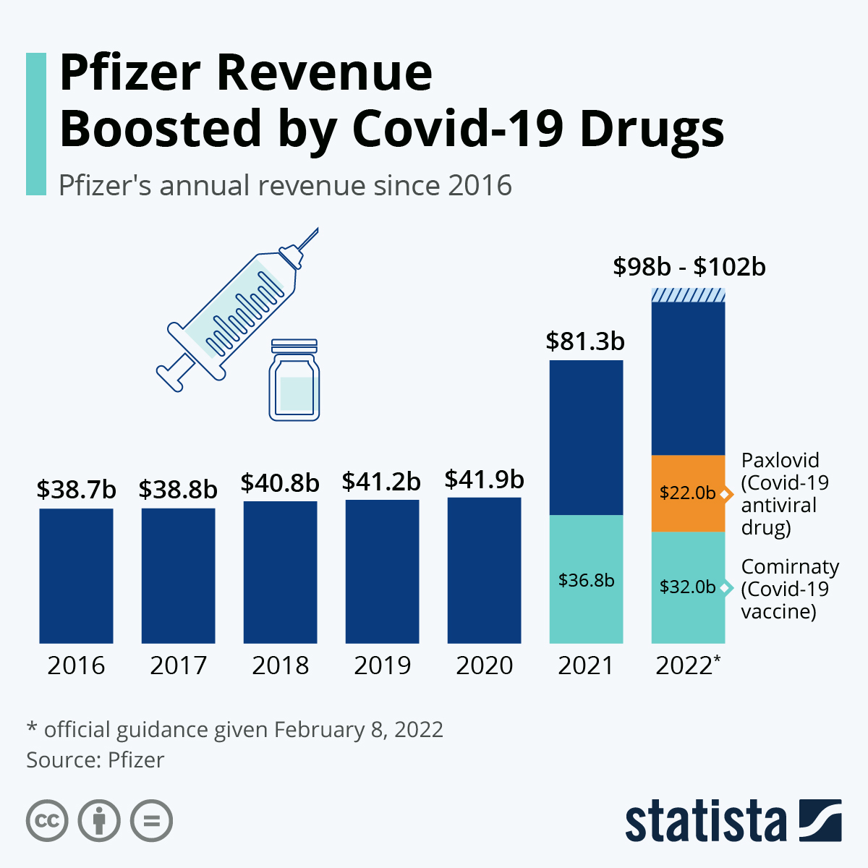
Development of oral antivirals
Pfizer introduced Paxlovid, a novel oral COVID-19 antiviral medication, in November 2021. Pfizer CEO Albert Bourla stated in January 2022 that the study findings for a fourth dose would not be available until March 2022.
He claimed that the company was forming a partnership with Novasep, a French company, to develop an anti-COVID tablet treatment. Additionally, he declared that the COVID vaccine was "safe and efficient" for kids.
Reports of patients exhibiting "rebound" symptoms following a five-day Paxlovid regimen surfaced in May 2022.

Slide 9
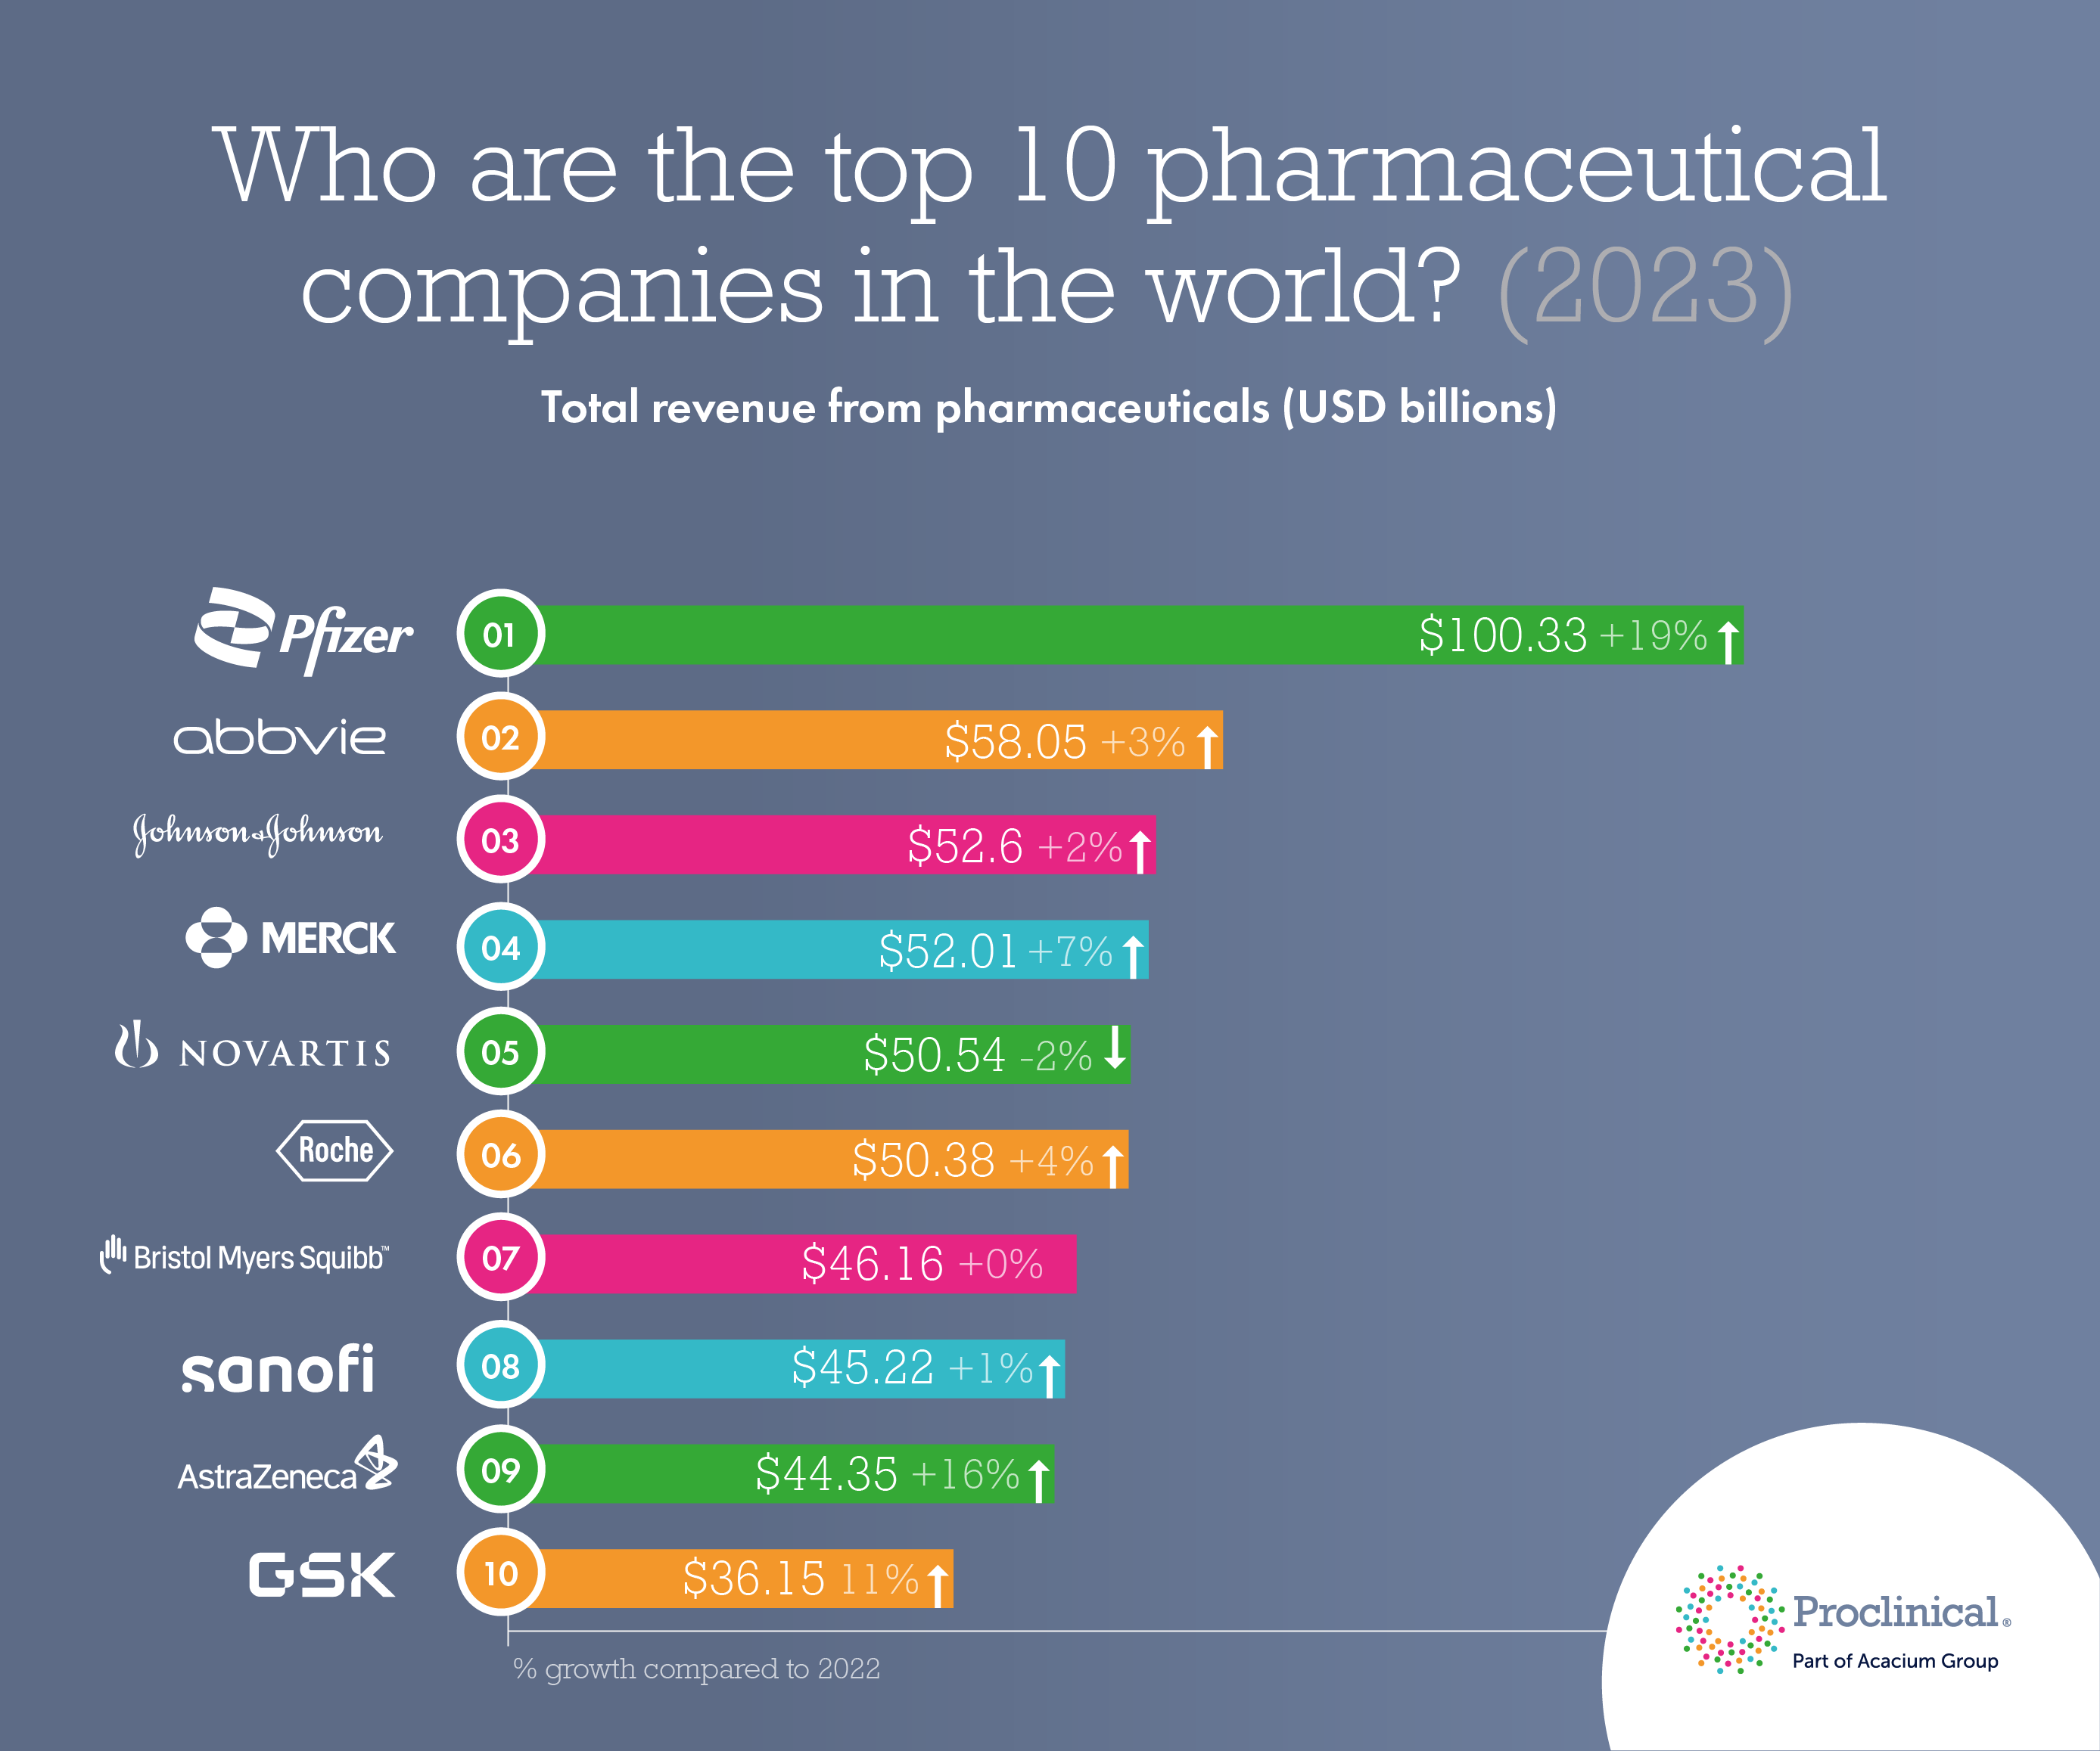
Industrial Competitors
Pfizer operates in a highly competitive pharmaceutical industry with numerous competitors, including other large multinational pharmaceutical companies like Johnson & Johnson, Novartis, Roche, and Merck & Co. Competitors often vie for market share in key therapeutic areas and engage in R&D to develop new treatments and technologies.

Slide 10

Macroeconomic Environment
Pfizer's growth strategy involves a combination of organic growth and strategic acquisitions. The company invests heavily in R&D to develop new medicines and therapies to address unmet medical needs.
Additionally, Pfizer has pursued mergers and acquisitions to enhance its product portfolio and expand its market presence.
In December 2023 Pfizer Completes Acquisition of Seagen Inc. (NASDAQ: SGEN), a global biotechnology company that discovers, develops and commercializes transformative cancer medicines for a total enterprise value of approximately $43 billion

Slide 11
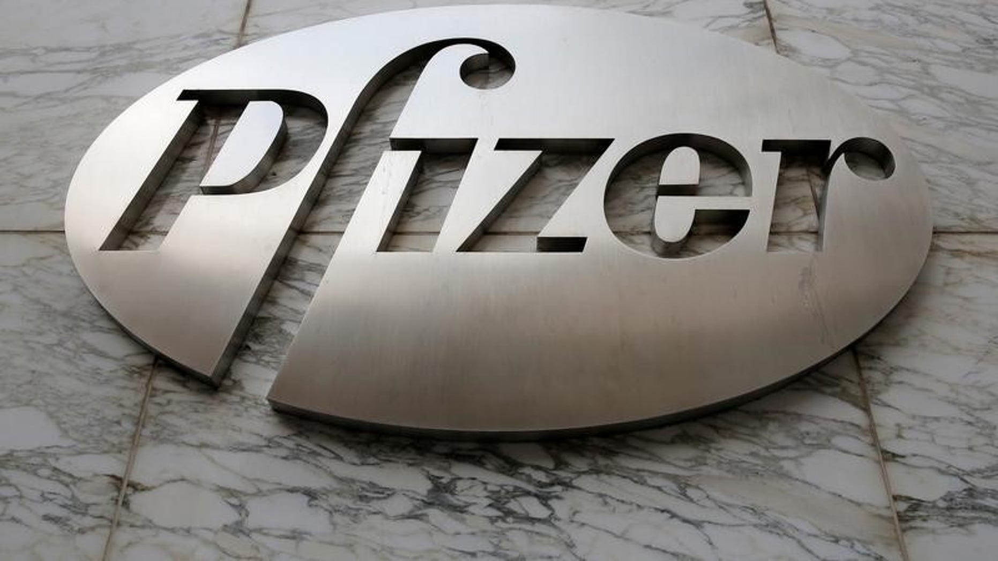
Approximate Market Share
Pfizer is among the largest pharmaceutical companies globally and holds significant market share in various therapeutic categories. However, market share can fluctuate depending on factors such as product performance, competition, regulatory approvals, and market dynamics.

Slide 12

Ratio and Valuation Analysis

Slide 13
Ratio Analysis
Profitability Ratios:
Gross Profit Margin | (Revenue - Cost of Revenue) / Revenue * 100 | 57.34%
Net Profit Margin | (Net Income / Revenue) * 100 | 3.62%
Return on Assets (ROA) | (Net Income / Total Assets) * 100 | 0.94%
Return on Equity (ROE) | (Net Income / Shareholders' Equity) * 100 | 2.38%
Operating Profit Margin | (Operating Income / Revenue) * 100 | 5.74%
Earnings per Share (EPS) | Net Income / Total Average Shares | 0.37
 | Total Average Shares = (Basic Average Shares + Diluted Average Shares) / 2
Liquidity Ratios:
Current Ratio | Current Assets / Current Liabilities | 0.91
Quick Ratio | (Current Assets - Inventory) / Current Liabilities | 0.69
Cash Ratio | Cash and Cash Equivalents / Current Liabilities | 0.06
Price-to-Earnings (P/E) Ratio: | Market Price per Share / Earnings per Share | 14.41
Dividend Payout Ratio | (Dividends Paid / Net Income) * 100 | -436%
Debt-to-Equity Ratio | Total Debt / Shareholders' Equity | 0.80
 | Total Debt = Current Debt + Long-term Debt | 70,845,000
Sustainable Growth Rate | (ROE * Retention Ratio) / (1 - (ROE * Retention Ratio)) | 14.64%
 | Retention Ratio=1−Dividend Payout Ratio
 | (ROE * Retention Ratio) | 12.77%

Slide 14
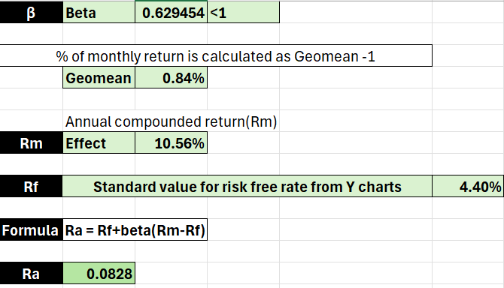
CAPM (Capital Asset Pricing Model)
CAPM is a financial model that describes the relationship between systematic risk (beta), expected return, and the risk-free rate of return.
It's used to determine the expected return of an investment based on its risk relative to the overall market.
The model helps investors assess whether an investment is adequately compensating for the risk taken.

Slide 15
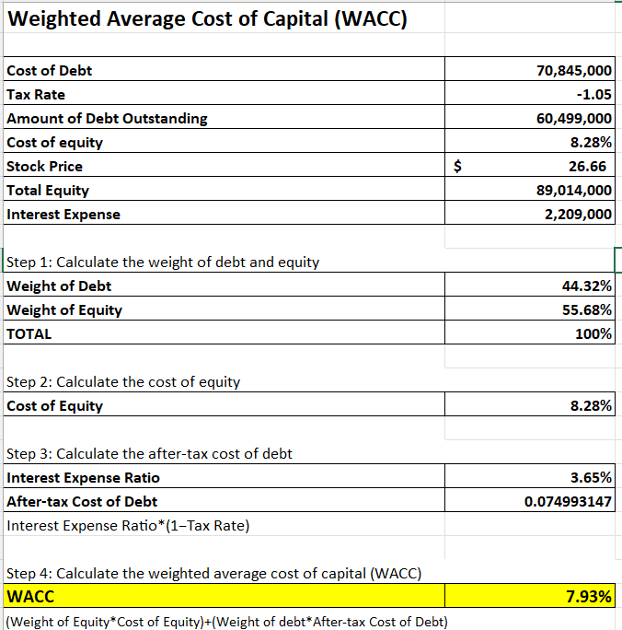
WACC (Weighted Average Cost of Capital)
WACC represents the minimum return that a company must generate on its existing assets to satisfy both equity and debt investors. It reflects the blended cost of capital from all sources of funding.
WACC is used as a discount rate in financial analysis, such as discounted cash flow (DCF) analysis, to evaluate investment opportunities. It helps determine whether an investment project will generate returns higher than the cost of capital.
In simpler terms, WACC tells us the rate at which the company's future cash flows must be discounted to determine their present value, considering the mix of debt and equity financing used to fund those cash flows.
The calculated WACC of approximately 7.93% represents the weighted average cost of capital for the company.

Slide 16
SMA(Simple Moving Average)
SMA20: SMA stands for Simple Moving Average, and the number 20 indicates the period over which the average is calculated, in this case, 20 days. SMA20 is calculated by summing up the closing prices of the last 20 days and dividing by 20. It provides a smoothed average of the stock price over the short term, helping traders identify trends and potential support or resistance levels.
SMA50: Similarly, SMA50 is the Simple Moving Average over a period of 50 days. It calculates the average closing price of the stock over the past 50 trading days. SMA50 is often used to assess the medium-term trend of a stock. When the current price crosses above the SMA50, it may indicate a bullish trend, while a crossover below SMA50 may suggest a bearish trend.

Slide 17
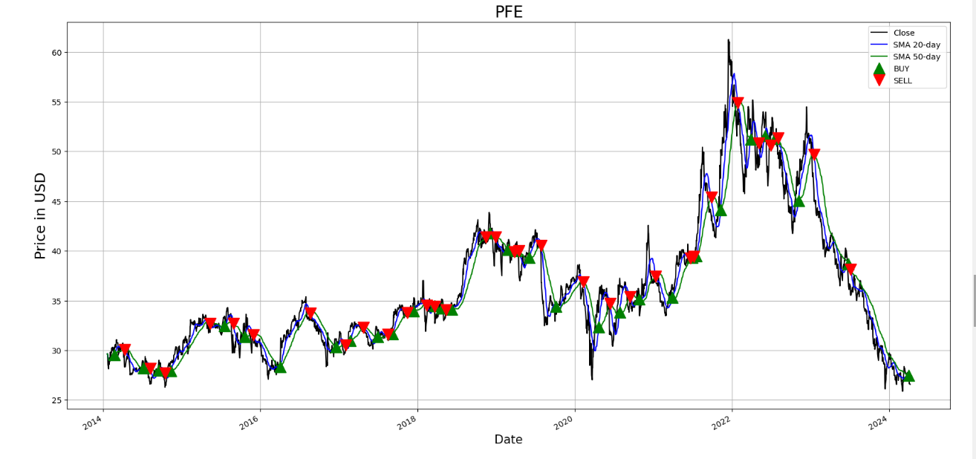
This plots the closing prices along with the 20-day and 50-day SMAs, highlighting buy signals with green triangles and Red triangles indicating the right time to sell, which is also known as golden cross are shown below for the past 10 years.

Slide 18
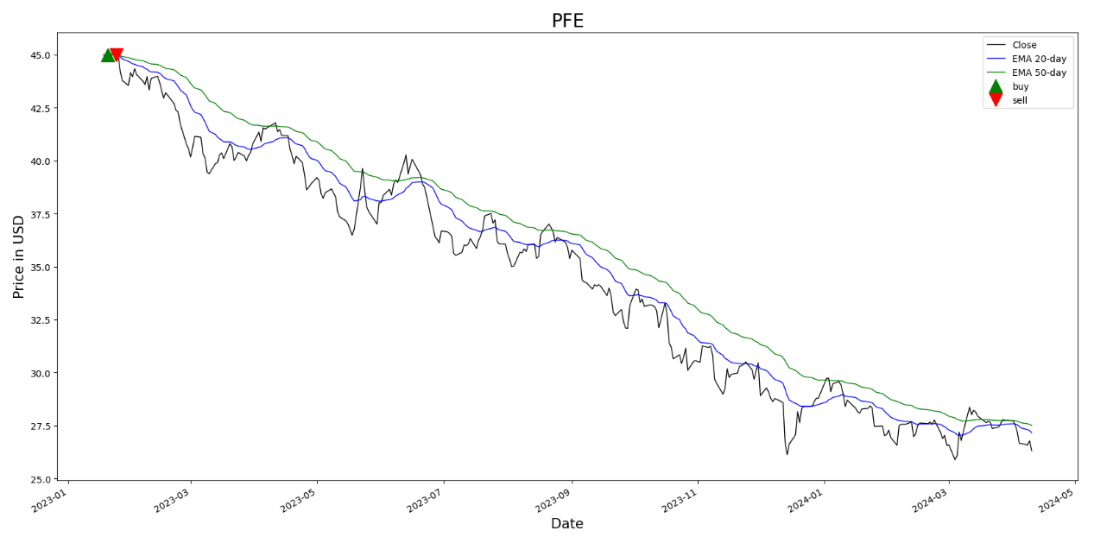
This visualizes stock price data, along with moving averages and buy/sell signals, providing insights into potential trading strategies based on EMA crossovers.

Slide 19
Technical Analysis

Slide 20
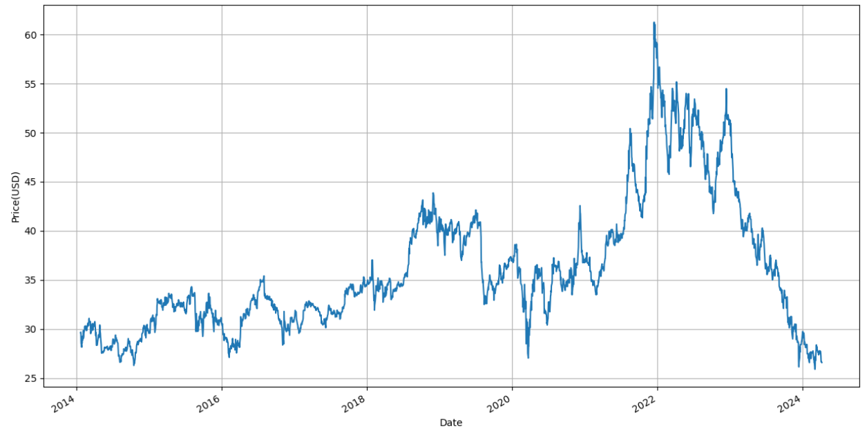
The last 10 year stock prices of Pfizer Inc. (PFE)

Slide 21
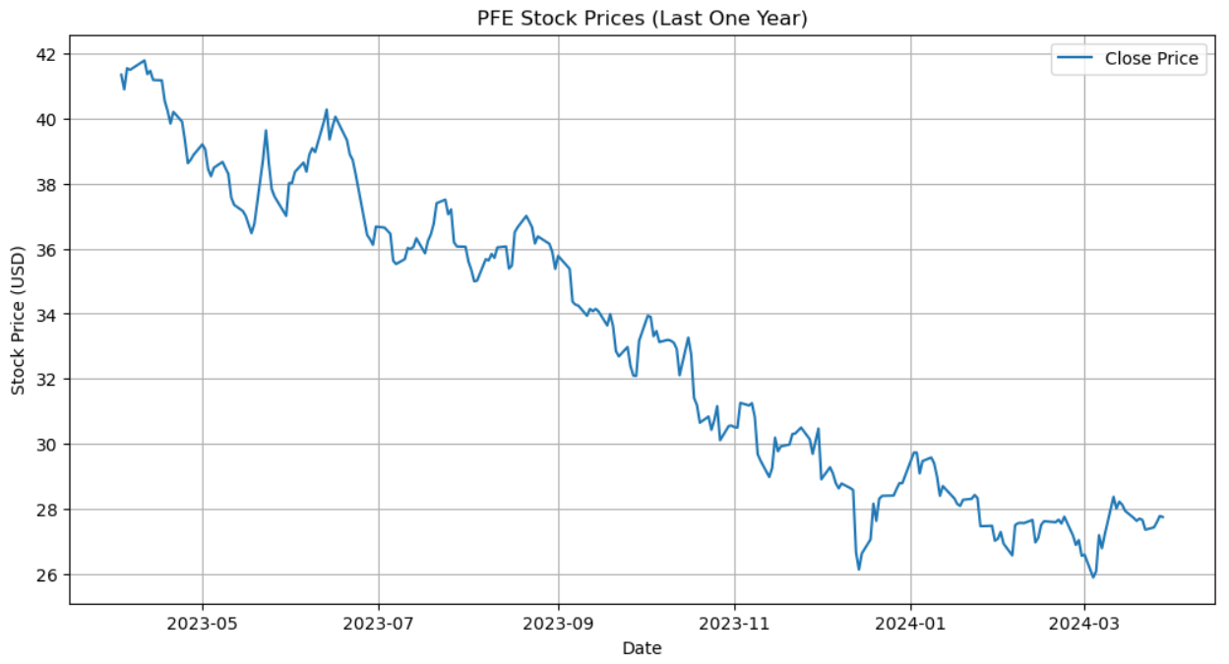
The last One-year stock prices of Pfizer Inc. (PFE)

Slide 22
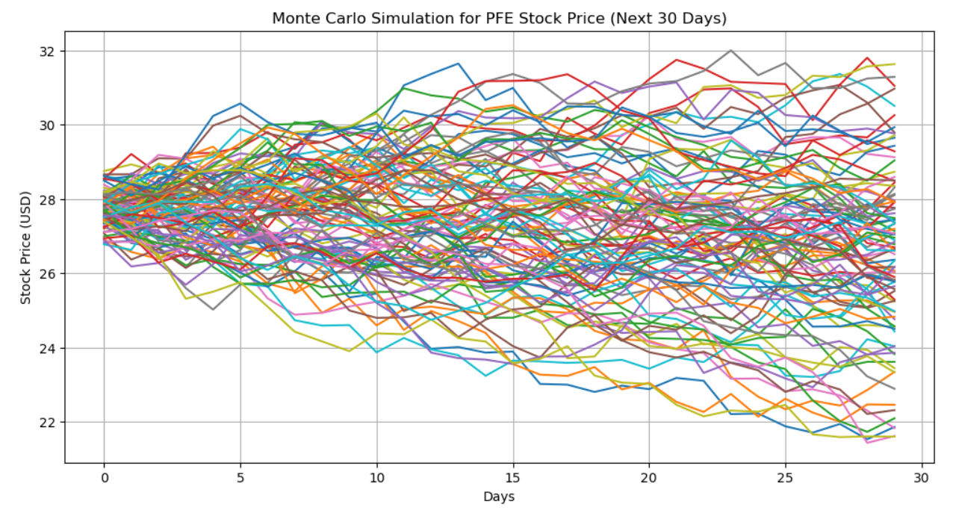
Monte Carlo Simulation
This is a method used to model the uncertainty of stock price movements by generating random scenarios based on statistical parameters.
We calculate the daily returns (percentage change in price) of the stock.
Then, we calculate the mean (average) and standard deviation (measure of volatility) of these daily returns.
Using these parameters, we simulate multiple possible future price paths for the stock for the next 30 days.
The simulated prices are plotted to visualize the potential range of future price movements.

Slide 23
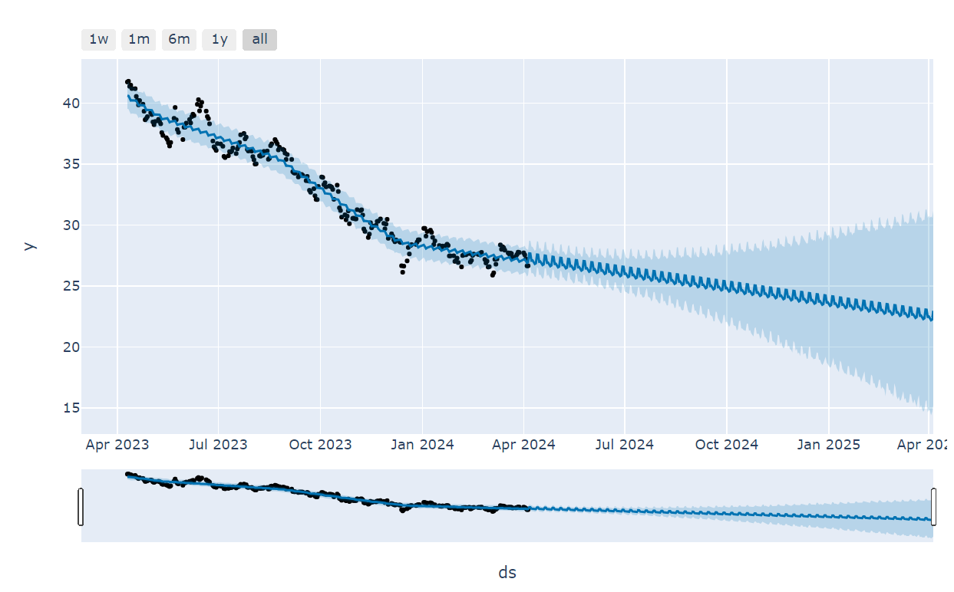
Facebook Prophet Forecasting
Facebook Prophet is a tool for time series forecasting developed by Facebook.
We prepare the stock price data in a format suitable for Prophet, renaming the columns as required.
We create a Prophet model, specifying that we want to include daily seasonality (patterns that repeat every day).
Then, we make a future dataframe for the next 30 days.
Prophet uses this data to make forecasts for the future stock prices.
Finally, we plot the forecasted prices along with confidence intervals to visualize the predicted trend.

Slide 24
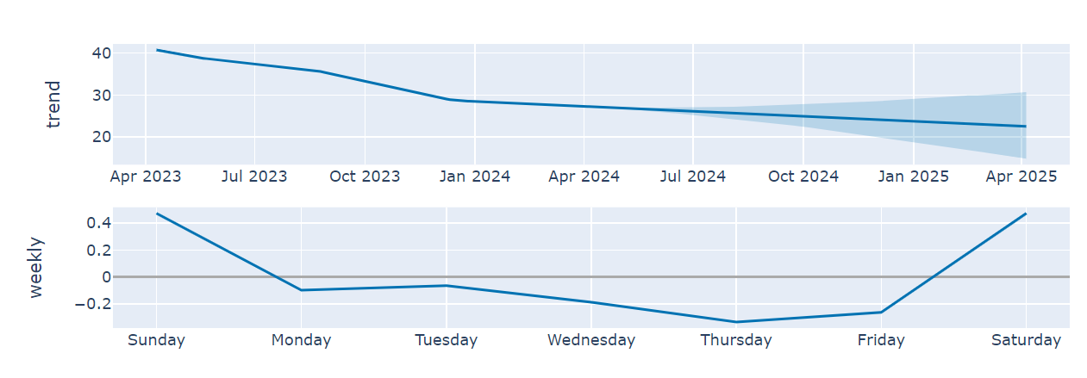
Trend: This plot shows the overall trend of the time series data, capturing its long-term movement. It helps identify whether the data is increasing, decreasing, or remaining relatively stable over time. Weekly Seasonality: If weekly seasonality is present in the data, this plot displays the periodic patterns that repeat on a weekly basis. It helps identify any consistent patterns that occur within each week.

Slide 25
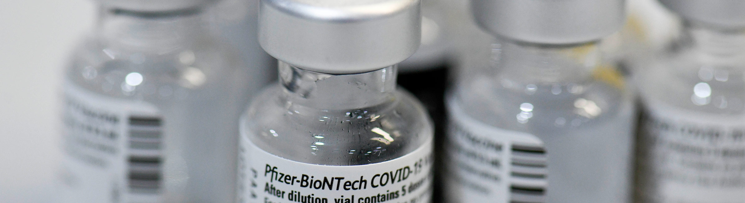
Recommendations

Slide 26

These recommendations are based on Pfizer Inc.'s analysis:
Potential for Investment: Pfizer Inc. is a reputable pharmaceutical business with a broad range of goods and services and a lengthy history of operation. It is a reliable option for long-term investment because to its widespread presence and ongoing investment in research and development.
Growth Prospects: Pfizer is anticipated to continue developing in the future given the macroeconomic climate and its strategic focus on organic growth, mergers, and acquisitions. Its potential for expansion is further enhanced by its solid standing in the healthcare sector and continuous efforts to develop novel medications and therapies.

Slide 27

Recommendation: Pfizer Inc. seems like a wise choice for investors based on the analysis. Purchasing Pfizer stock may be an option for investors looking for stability and possible development in the healthcare industry. It is a desirable investment due to its steady performance, market share, and potential for future expansion. Hold Recommendation: If current investors are pleased with Pfizer's performance and think the company has room to develop in the long run, hanging onto their shares may also be a wise move.
Additional Analysis: Before making any investment decisions, prospective investors should evaluate their risk tolerance, carry out independent research, and speak with financial experts. Making wise investing decisions also requires remaining up to date on corporate advancements, regulatory changes, and industry trends.

Slide 28
References
https://ca.finance.yahoo.com/quote/PFE/
https://www.pfizer.com/news/press-release/press-release-detail/pfizer-completes-acquisition-seagen
https://ca.marketscreener.com/quote/stock/PFIZER-INC-23365019/
https://investors.pfizer.com/Investors/Overview/default.aspx
https://businessmodelanalyst.com/pfizer-business-model/
https://www.nasdaq.com/market-activity/stocks/pfe

Slide 29

Thank You

